Slide 1
Chapter 2
Evolution of the Major Programming Languages

Slide 2
Chapter 2 Topics
Zuse’s Plankalkül
Minimal Hardware Programming: Pseudocodes
The IBM 704 and Fortran
Functional Programming: Lisp
The First Step Toward Sophistication: ALGOL 60
Computerizing Business Records: COBOL
The Beginnings of Timesharing: Basic
Copyright © 2015 Pearson. All rights reserved.
1-<number>

Slide 3
Chapter 2 Topics (continued)
Everything for Everybody: PL/I
Two Early Dynamic Languages: APL and SNOBOL
The Beginnings of Data Abstraction: SIMULA 67
Orthogonal Design: ALGOL 68
Some Early Descendants of the ALGOLs
Programming Based on Logic: Prolog
History's Largest Design Effort: Ada
Copyright © 2015 Pearson. All rights reserved.
1-<number>

Slide 4
Chapter 2 Topics (continued)
Object-Oriented Programming: Smalltalk
Combining Imperative ad Object-Oriented Features: C++
An Imperative-Based Object-Oriented Language: Java
Scripting Languages
The Flagship .NET Language: C#
Markup/Programming Hybrid Languages
Copyright © 2015 Pearson. All rights reserved.
1-<number>

Slide 5
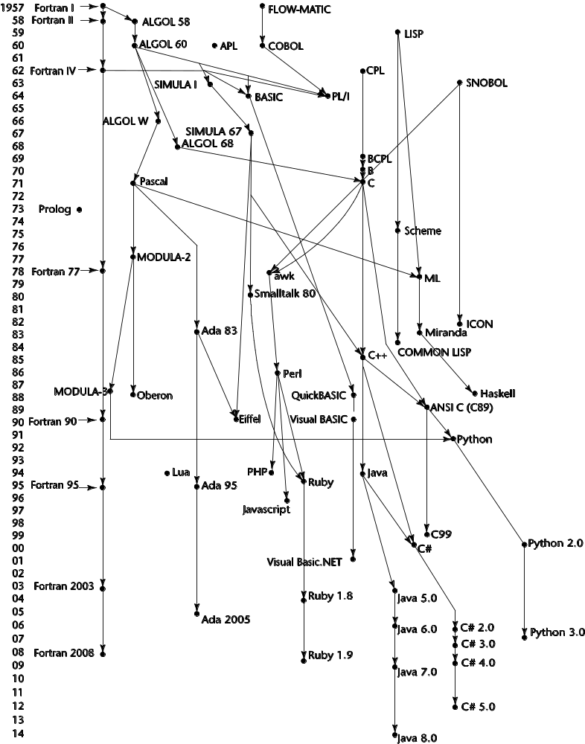
Genealogy of Common Languages
Copyright © 2015 Pearson. All rights reserved.
1-<number>

Slide 6
Zuse’s Programming Language -Plankalkül
Designed in 1945, but not published until 1972
Never implemented
Advanced data structures
  floating point, arrays, records
Invariants
Copyright © 2015 Pearson. All rights reserved.
1-<number>

Slide 7
Plankalkül Syntax
An assignment statement to assign the expression A[4] + 1 to A[5]
| A + 1 => A
V | 4 5 (subscripts)
S | 1.n 1.n (data types, in this case integer of n bits)
Copyright © 2015 Pearson. All rights reserved.
1-<number>

Slide 8
Minimal Hardware Programming: Pseudocodes (their original name)
What was wrong with using machine code?
  Poor readability
  Poor modifiability
  Expression coding was tedious
  Machine deficiencies--no indexing or floating point
Copyright © 2015 Pearson. All rights reserved.
1-<number>

Slide 9
Pseudocodes: Short Code
Short Code developed by Mauchly in 1949 for BINAC computers
  Expressions were coded, left to right
  Example of operations:
01 – 06 abs value 1n (n+2)nd power
02 ) 07 + 2n (n+2)nd root
03 = 08 pause 4n if <= n
04 / 09 ( 58 print and tab
Copyright © 2015 Pearson. All rights reserved.
1-<number>

Slide 10
Pseudocodes: Speedcoding
Speedcoding developed by Backus in 1954 for IBM 701
  Pseudo ops for arithmetic and math functions
  Conditional and unconditional branching
  Auto-increment registers for array access
  Slow! (4.2 milliseconds for an add instruction)
  Only 700 words left for user program (rest of memory taken up by the Interpreter)
Copyright © 2015 Pearson. All rights reserved.
1-<number>

Slide 11
Pseudocodes: Related Systems
The UNIVAC Compiling System
  Developed by a team led by Grace Hopper
  Pseudocode expanded into machine code
David J. Wheeler (Cambridge University)
  developed a method of using blocks of re-locatable addresses to solve the problem of absolute addressing
Copyright © 2015 Pearson. All rights reserved.
1-<number>

Slide 12
IBM 704 and Fortran
Fortran 0: 1954 - not implemented
Fortran I:1957
  Designed for the new IBM 704, which had index registers and floating point hardware (basically a math brain to do calculations).
  - This led to the idea of compiled programming languages, because there was no place to hide the cost of interpretation (no floating-point software)
  Environment of development
    Computers were small and unreliable
    Applications were scientific
    No programming methodology or tools
    Machine efficiency was the most important concern
Copyright © 2015 Pearson. All rights reserved.
1-<number>

Slide 13
Design Process of Fortran
Impact of environment on design of Fortran I
  No need for dynamic storage
  Need good array handling and counting loops
  No string handling, decimal arithmetic, or powerful input/output (for business software)
Copyright © 2015 Pearson. All rights reserved.
1-<number>

Slide 14
Fortran I Overview
First implemented version of Fortran
  Names could have up to six characters
  Post-test counting loop (DO)
  Formatted I/O
  User-defined subprograms
  Three-way selection statement (arithmetic IF)
  No data typing statements (variables starting with i, j, k, l and m were intger, all others float).
Copyright © 2015 Pearson. All rights reserved.
1-<number>

Slide 15
Fortran I Overview (continued)
First implemented version of FORTRAN
  No separate compilation
  Compiler released in April 1957, after 18 worker-years of effort
  Programs larger than 400 lines rarely compiled correctly, mainly due to poor reliability of 704
  Code was very fast
  Quickly became widely used
Copyright © 2015 Pearson. All rights reserved.
1-<number>

Slide 16
Fortran II
Distributed in 1958
  Independent compilation (sub-programs could be compiled on their own)
  Fixed the bugs
Copyright © 2015 Pearson. All rights reserved.
1-<number>

Slide 17
Fortran IV
Evolved during 1960-62
  Explicit type declarations
  Logical selection statement
  Subprogram names could be parameters
  ANSI standard in 1966
Copyright © 2015 Pearson. All rights reserved.
1-<number>

Slide 18
Fortran 77
Became the new standard in 1978
  Character string handling
  Logical loop control statement
  IF-THEN-ELSE statement
Copyright © 2015 Pearson. All rights reserved.
1-<number>

Slide 19
Fortran 90
Most significant changes from Fortran 77
  Modules
  Dynamic arrays
  Pointers
  Recursion
  CASE statement
  Parameter type checking
Copyright © 2015 Pearson. All rights reserved.
1-<number>

Slide 20
Latest versions of Fortran
Fortran 95 – relatively minor additions, plus some deletions
Fortran 2003 – support for OOP, procedure pointers, interoperability with C
Fortran 2008 – blocks for local scopes, co-arrays, Do Concurrent
Copyright © 2015 Pearson. All rights reserved.
1-<number>

Slide 21
Fortran Evaluation
Highly optimizing compilers (all versions before 90)
  Types and storage of all variables are fixed before run time
Dramatically changed forever the way computers are used
Copyright © 2015 Pearson. All rights reserved.
1-<number>

Slide 22
Functional Programming: Lisp
LISP Processing language
  Designed at MIT by McCarthy
AI research needed a language to
  Process data in lists (rather than arrays)
  Symbolic computation (rather than numeric)
Only two data types: atoms and lists
Syntax is based on lambda calculus
Copyright © 2015 Pearson. All rights reserved.
1-<number>

Slide 23
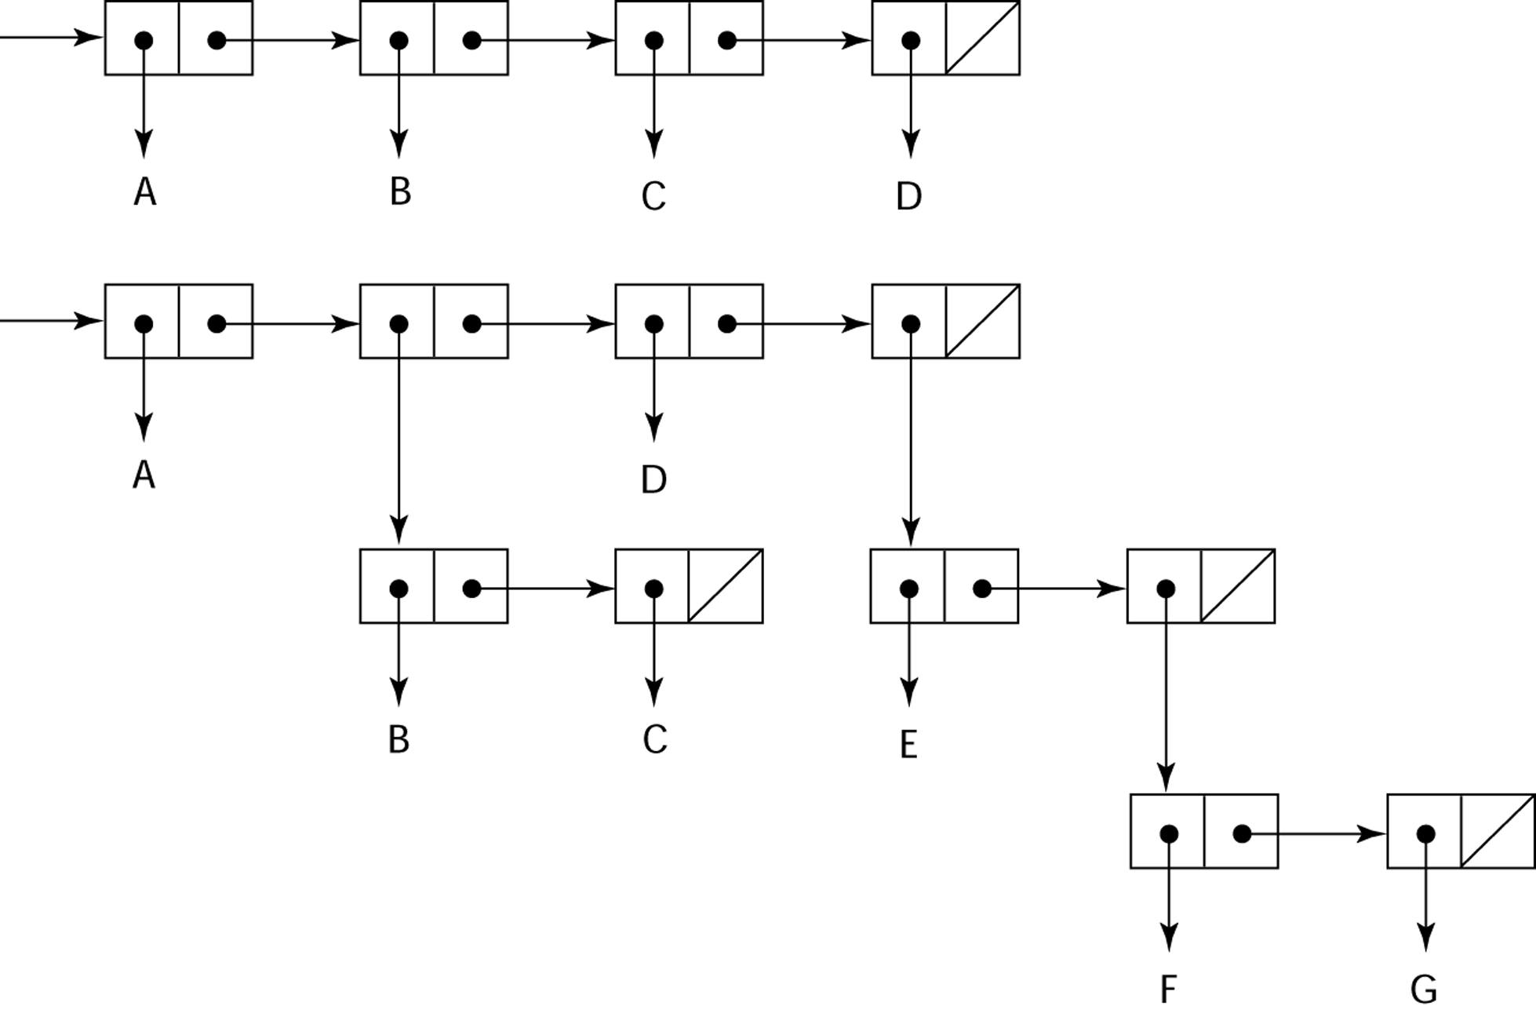
Representation of Two Lisp Lists
Representing the lists (A B C D)
and (A (B C) D (E (F G)))
Copyright © 2015 Pearson. All rights reserved.
1-<number>

Slide 24
Lisp Evaluation
Pioneered functional programming
  No need for variables or assignment
  Control via recursion and conditional expressions
Still the dominant language for AI
Common Lisp and Scheme are contemporary dialects of Lisp
ML, Haskell, and F# are also functional programming languages, but use very different syntax
Copyright © 2015 Pearson. All rights reserved.
1-<number>

Slide 25
Scheme
Developed at MIT in mid 1970s
Small
Extensive use of static scoping
Functions as first-class entities
Simple syntax (and small size) make it ideal for educational applications
Copyright © 2015 Pearson. All rights reserved.
1-<number>

Slide 26
Common Lisp
An effort to combine features of several dialects of Lisp into a single language
Large, complex, used in industry for some large applications
Copyright © 2015 Pearson. All rights reserved.
1-<number>

Slide 27
The First Step Toward Sophistication: ALGOL 60
Environment of development
  FORTRAN had (barely) arrived for IBM 70x
  Many other languages were being developed, all for specific machines
  No portable language; all were machine- dependent
  No universal language for communicating algorithms
ALGOL 60 was the result of efforts to design a universal language
Copyright © 2015 Pearson. All rights reserved.
1-<number>

Slide 28
Early Design Process
ACM and GAMM met for four days for design (May 27 to June 1, 1958)
Goals of the language
  Close to mathematical notation
  Good for describing algorithms
  Must be translatable to machine code
Copyright © 2015 Pearson. All rights reserved.
1-<number>

Slide 29
ALGOL 58
Concept of type was formalized
Names could be any length
Arrays could have any number of subscripts
Parameters were separated by mode (in & out)
Subscripts were placed in brackets
Compound statements (begin ... end)
Semicolon as a statement separator
Assignment operator was :=
if had an else-if clause
No I/O - “would make it machine dependent”
Copyright © 2015 Pearson. All rights reserved.
1-<number>

Slide 30
ALGOL 58 Implementation
Not meant to be implemented, but variations of it were (MAD, JOVIAL)
Although IBM was initially enthusiastic, all support was dropped by mid 1959
Copyright © 2015 Pearson. All rights reserved.
1-<number>

Slide 31
ALGOL 60 Overview
Modified ALGOL 58 at 6-day meeting in Paris
New features
  Block structure (local scope)
  Two parameter passing methods
  Subprogram recursion
  Stack-dynamic arrays
  Still no I/O and no string handling
Copyright © 2015 Pearson. All rights reserved.
1-<number>

Slide 32
ALGOL 60 Evaluation
Successes
  It was the standard way to publish algorithms for over 20 years
  All subsequent imperative languages are based on it
  First machine-independent language
  First language whose syntax was formally defined (BNF:Backus–Naur Form widely used as a notation for the grammars of computer programming languages)
Copyright © 2015 Pearson. All rights reserved.
1-<number>

Slide 33
ALGOL 60 Evaluation (continued)
Failure
  Never widely used, especially in U.S.
  Reasons
    Lack of I/O and the character set made programs non-portable
    Too flexible--hard to implement
    Entrenchment of Fortran
    Formal syntax description
    Lack of support from IBM
Copyright © 2015 Pearson. All rights reserved.
1-<number>

Slide 34
Computerizing Business Records: COBOL
Environment of development
  UNIVAC was beginning to use FLOW-MATIC
  USAF was beginning to use AIMACO
  IBM was developing COMTRAN
Copyright © 2015 Pearson. All rights reserved.
1-<number>

Slide 35
COBOL Historical Background
Based on FLOW-MATIC
FLOW-MATIC features
  Names up to 12 characters, with embedded hyphens
  English names for arithmetic operators (no arithmetic expressions)
  Data and code were completely separate
  The first word in every statement was a verb
Copyright © 2015 Pearson. All rights reserved.
1-<number>

Slide 36
COBOL Design Process
First Design Meeting (Pentagon) - May 1959
Design goals
  Must look like simple English
  Must be easy to use, even if that means it will be less powerful
  Must broaden the base of computer users
  Must not be biased by current compiler problems
Design committee members were all from computer manufacturers and DoD branches
Design Problems: arithmetic expressions? subscripts? Fights among manufacturers
Copyright © 2015 Pearson. All rights reserved.
1-<number>

Slide 37
COBOL Evaluation
Contributions
  First macro facility in a high-level language
  Hierarchical data structures (records)
  Nested selection statements
  Long names (up to 30 characters), with hyphens
  Separate data division
Copyright © 2015 Pearson. All rights reserved.
1-<number>

Slide 38
COBOL: DoD Influence
First language required by DoD
  would have failed without DoD
Still the most widely used business applications language
Copyright © 2015 Pearson. All rights reserved.
1-<number>

Slide 39
The Beginning of Timesharing: Basic
Designed by Kemeny & Kurtz at Dartmouth
Design Goals:
  Easy to learn and use for non-science students
  Must be “pleasant and friendly”
  Fast turnaround for homework
  Free and private access
  User time is more important than computer time
Current popular dialect: Visual Basic
First widely used language with time sharing
Copyright © 2015 Pearson. All rights reserved.
1-<number>

Slide 40
2.8 Everything for Everybody: PL/I
Designed by IBM and SHARE
Computing situation in 1964 (IBM's point of view)
  Scientific computing
    IBM 1620 and 7090 computers
    FORTRAN
    SHARE user group
  Business computing
    IBM 1401, 7080 computers
    COBOL
    GUIDE user group
Copyright © 2015 Pearson. All rights reserved.
1-<number>

Slide 41
PL/I: Background
By 1963
  Scientific users began to need more elaborate I/O, like COBOL had; business users began to need floating point and arrays for MIS
  It looked like many shops would begin to need two kinds of computers, languages, and support staff--too costly
The obvious solution
  Build a new computer to do both kinds of applications
  Design a new language to do both kinds of applications
Copyright © 2015 Pearson. All rights reserved.
1-<number>

Slide 42
PL/I: Design Process
Designed in five months by the 3 X 3 Committee
  Three members from IBM, three members from SHARE
Initial concept
  An extension of Fortran IV
Initially called NPL (New Programming Language)
Name changed to PL/I in 1965
Copyright © 2015 Pearson. All rights reserved.
1-<number>

Slide 43
PL/I: Evaluation
PL/I contributions
  First unit-level concurrency
  First exception handling
  Switch-selectable recursion
  First pointer data type
  First array cross sections
Concerns
  Many new features were poorly designed
  Too large and too complex
Copyright © 2015 Pearson. All rights reserved.
1-<number>

Slide 44
Two Early Dynamic Languages: APL and SNOBOL
Characterized by dynamic typing and dynamic storage allocation
Variables are untyped
  A variable acquires a type when it is assigned a value
Storage is allocated to a variable when it is assigned a value
Copyright © 2015 Pearson. All rights reserved.
1-<number>

Slide 45
APL: A Programming Language
Designed as a hardware description language at IBM by Ken Iverson around 1960
  Highly expressive (many operators, for both scalars and arrays of various dimensions)
  Programs are very difficult to read
Still in use; minimal changes
Copyright © 2015 Pearson. All rights reserved.
1-<number>

Slide 46
SNOBOL
Designed as a string manipulation language at Bell Labs by Farber, Griswold, and Polensky in 1964
Powerful operators for string pattern matching
Slower than alternative languages (and thus no longer used for writing editors)
Still used for certain text processing tasks
Copyright © 2015 Pearson. All rights reserved.
1-<number>

Slide 47
The Beginning of Data Abstraction: SIMULA 67
Designed primarily for system simulation in Norway by Nygaard and Dahl
Based on ALGOL 60 and SIMULA I
Primary Contributions
  Coroutines - a kind of subprogram
  Classes, objects, and inheritance
Copyright © 2015 Pearson. All rights reserved.
1-<number>

Slide 48
Orthogonal Design: ALGOL 68
From the continued development of ALGOL 60 but not a superset of that language
Source of several new ideas (even though the language itself never achieved widespread use)
Design is based on the concept of orthogonality
  A few basic concepts, plus a few combining mechanisms
Copyright © 2015 Pearson. All rights reserved.
1-<number>

Slide 49
ALGOL 68 Evaluation
Contributions
  User-defined data structures
  Reference types
  Dynamic arrays (called flex arrays)
Comments
  Less usage than ALGOL 60
  Had strong influence on subsequent languages, especially Pascal, C, and Ada
Copyright © 2015 Pearson. All rights reserved.
1-<number>

Slide 50
Pascal - 1971
Developed by Wirth (a former member of the ALGOL 68 committee)
Designed for teaching structured programming
Small, simple, nothing really new
Largest impact was on teaching programming
  From mid-1970s until the late 1990s, it was the most widely used language for teaching programming
Copyright © 2015 Pearson. All rights reserved.
1-<number>

Slide 51
C - 1972
Designed for systems programming (at Bell Labs by Dennis Richie)
Evolved primarily from BCLP and B, but also ALGOL 68
Powerful set of operators, but poor type checking
Initially spread through UNIX
Though designed as a systems language, it has been used in many application areas
Copyright © 2015 Pearson. All rights reserved.
1-<number>

Slide 52
Programming Based on Logic: Prolog
Developed, by Comerauer and Roussel (University of Aix-Marseille), with help from Kowalski ( University of Edinburgh)
Based on formal logic
Non-procedural
Can be summarized as being an intelligent database system that uses an inferencing process to infer the truth of given queries
Comparatively inefficient
Few application areas
Copyright © 2015 Pearson. All rights reserved.
1-<number>

Slide 53
History’s Largest Design Effort: Ada
Huge design effort, involving hundreds of people, much money, and about eight years
Sequence of requirements (1975-1978)
  (Strawman, Woodman, Tinman, Ironman, Steelman)
Named Ada after Augusta Ada Byron, the first programmer
Copyright © 2015 Pearson. All rights reserved.
1-<number>

Slide 54
Ada Evaluation
Contributions
  Packages - support for data abstraction
  Exception handling - elaborate
  Generic program units
  Concurrency - through the tasking model
Comments
  Competitive design
  Included all that was then known about software engineering and language design
  First compilers were very difficult; the first really usable compiler came nearly five years after the language design was completed
Copyright © 2015 Pearson. All rights reserved.
1-<number>

Slide 55
Ada 95
Ada 95 (began in 1988)
  Support for OOP through type derivation
  Better control mechanisms for shared data
  New concurrency features
  More flexible libraries
Ada 2005
  Interfaces and synchronizing interfaces
Popularity suffered because the DoD no longer requires its use but also because of popularity of C++
Copyright © 2015 Pearson. All rights reserved.
1-<number>

Slide 56
Object-Oriented Programming: Smalltalk
Developed at Xerox PARC, initially by Alan Kay, later by Adele Goldberg
First full implementation of an object-oriented language (data abstraction, inheritance, and dynamic binding)
Pioneered the graphical user interface design
Promoted OOP
Copyright © 2015 Pearson. All rights reserved.
1-<number>

Slide 57
Combining Imperative and Object-Oriented Programming: C++
Developed at Bell Labs by Stroustrup in 1980
Evolved from C and SIMULA 67
Facilities for object-oriented programming, taken partially from SIMULA 67
A large and complex language, in part because it supports both procedural and OO programming
Rapidly grew in popularity, along with OOP
ANSI standard approved in November 1997
Microsoft’s version: MC++
  Properties, delegates, interfaces, no multiple inheritance
Copyright © 2015 Pearson. All rights reserved.
1-<number>

Slide 58
A Related OOP Language
Objective-C (designed by Brad Cox – early 1980s)
  C plus support for OOP based on Smalltalk
  Uses Smalltalk’s method calling syntax
  Used by Apple for systems programs
Copyright © 2015 Pearson. All rights reserved.
1-<number>

Slide 59
An Imperative-Based Object-Oriented Language: Java
Developed at Sun in the early 1990s
  C and C++ were not satisfactory for embedded electronic devices
Based on C++
  Significantly simplified (does not include struct, union, enum, pointer arithmetic, and half of the assignment coercions of C++)
  Supports only OOP
  Has references, but not pointers
  Includes support for applets and a form of concurrency
Copyright © 2015 Pearson. All rights reserved.
1-<number>

Slide 60
Java Evaluation
Eliminated many unsafe features of C++
Supports concurrency
Libraries for applets, GUIs, database access
Portable: Java Virtual Machine concept, JIT compilers
Widely used for Web programming
Use increased faster than any previous language
Most recent version, 8, released in 2014
Copyright © 2015 Pearson. All rights reserved.
1-<number>

Slide 61
Scripting Languages for the Web
Perl
  Designed by Larry Wall—first released in 1987
  Variables are statically typed but implicitly declared
  Three distinctive namespaces, denoted by the first character of a
  variable’s name
  Powerful, but somewhat dangerous
  Gained widespread use for CGI programming on the Web
  Also used for a replacement for UNIX system administration language
JavaScript
  Began at Netscape, but later became a joint venture of Netscape and Sun Microsystems
  A client-side HTML-embedded scripting language, often used to create dynamic HTML documents
  Purely interpreted
  Related to Java only through similar syntax
PHP
  PHP: Hypertext Preprocessor, designed by Rasmus Lerdorf
  A server-side HTML-embedded scripting language, often used for form processing and database access through the Web
  Purely interpreted
Copyright © 2015 Pearson. All rights reserved.
1-<number>

Slide 62
Scripting Languages for the Web
Python
  An OO interpreted scripting language
  Type checked but dynamically typed
  Used for CGI programming and form processing
  Dynamically typed, but type checked
  Supports lists, tuples, and hashes
Ruby
  Designed in Japan by Yukihiro Matsumoto (a.k.a, “Matz”)
  Began as a replacement for Perl and Python
  A pure object-oriented scripting language
  - All data are objects
  Most operators are implemented as methods, which can be redefined by user code
  Purely interpreted
Copyright © 2015 Pearson. All rights reserved.
1-<number>

Slide 63
Scripting Languages for the Web
Lua
  An OO interpreted scripting language
  Type checked but dynamically typed
  Used for CGI programming and form processing
  Dynamically typed, but type checked
  Supports lists, tuples, and hashes, all with its single data structure,
  the table
  Easily extendable
Copyright © 2015 Pearson. All rights reserved.
1-<number>

Slide 64
The Flagship .NET Language: C#
Part of the .NET development platform (2000)
Based on C++ , Java, and Delphi
Includes pointers, delegates, properties, enumeration types, a limited kind of dynamic typing, and anonymous types
Is evolving rapidly
Copyright © 2015 Pearson. All rights reserved.
1-<number>

Slide 65
Markup/Programming Hybrid Languages
XSLT
  eXtensible Markup Language (XML): a metamarkup language
  eXtensible Stylesheet Language Transformation (XSTL) transforms XML documents for display
  Programming constructs (e.g., looping)
JSP
  Java Server Pages: a collection of technologies to support dynamic Web documents
  JSTL, a JSP library, includes programming constructs in the form of HTML elements
Copyright © 2015 Pearson. All rights reserved.
1-<number>

Slide 66
Summary
Development, development environment, and evaluation of a number of important programming languages
Perspective into current issues in language design
Copyright © 2015 Pearson. All rights reserved.
1-<number>

